Slide 1

TfL Academic Confidentiality Agreement Overview
Version 23Feb2021

Slide 2

Introduction
We are keen to establish productive research collaborations with academic partners aligned to our priorities which support us to achieve the Mayor’s Transport Strategy, creating a fairer, greener, healthier and more prosperous city. We value the potential of research to provide cost-effective innovative, cutting-edge thinking that drives unique benefits for customers and staff.
A unique benefit of these partnerships is controlled access to confidential data and information. This needs to be appropriately and effectively managed to reduce the risk of security incidents and data breaches so we have developed a framework specifically for academic partnerships. Under GDPR, it is also a legal requirement that we have a written contract in place with all of Data Processors and only appoint those who can provide ‘sufficient guarantees’ that the requirements of the GDPR will be met and the rights of data subjects protected.
Our standard, non-negotiable, set of terms and conditions known as an Academic Confidentiality Agreement (ACA) has been developed to cover not only confidentiality requirements but also wider considerations including Intellectual Property and wider publication and presentation of research outputs.
Please note:
1) where the project is with spin offs of an academic partner, it is likely an alternative commercial agreement will be needed.
2) TfL must not be involved in any research that would involve an advantage being granted by a public authority through use of state resources on a selective basis to any organisations that could potentially distort competition and trade in the European Union (state-aid).

Slide 3
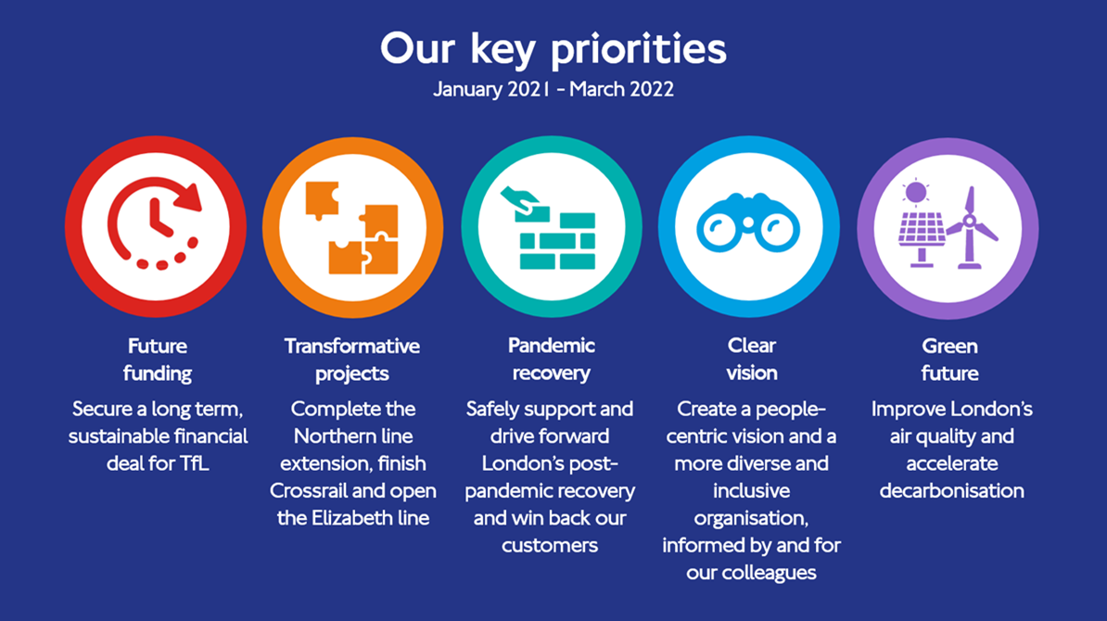

Slide 4
Benefits of our ACA for you....
Privileged access to confidential TfL data and information normally only available
to TfL staff
SMEs
Real life
Impact
Test-bed
TfL Brand
Data
Deeper relationships and more frequent contact with TfL subject matter experts
Ability to partner on
real-world challenges
Potential to demonstrate real-world impact of innovative academic ideas and enhance University reputation ranking
Potential access to test-bed facilities
Enhanced kudos and credibility for University through alignment with the well-established and globally recognised TfL brand

Slide 5
What documents will you receive?
Document | Notes
F9.1 Academic Confidentiality Agreement (ACA) | There are two versions depending whether the project has privacy / GPDR considerations The agreements need to be executed by authorised signatories before the project can commence and any confidential data can be exchanged Subject to a Cyber Security assessment
F1554 Data Adequacy Form NB: this form may be replaced with an updated process during 2021 | Used to help demonstrate adequate information security provisions will be in place to protect any TfL materials being supplied to undertake the research and who will be responsible for data deletion on completion of the project Outlines the annual training requirements expected of all team members Our Cyber Security team may also ask you to complete additional forms / provided more detailed information
F7526 Data Protection Impact Assessment (DPIA) | Any initiative, project or proposal to change processes that involves the processing of personal information (or the use of privacy intrusive technologies) is likely to give rise to various privacy and data protection concerns. Undertaking a DPIA helps to ensure that data protection risks are identified as soon as possible. The DPIA should continue to be maintained and updated throughout the project lifecycle. The GDPR makes a Data Protection Impact Assessment (DPIA) mandatory for certain types of processing, or any other processing that is likely to result in a high risk to individual’s interests.
Supporting documents | You will also receive additional documents providing additional details which we kindly ask that all members of the project team read and abide by: Information Governance Dos and Don’ts Guide Details of TfL Information Security Policies covering data handling, transfer, sensitivity labelling etc. If you are being provided with access to our OneLondon computing environment, you will also be expected to read and abide by similar policies such as our Code of Connection.

Slide 6

What we expect from you....
The whole project team are familiar and compliant with all contractual terms and safeguard TfL data at all times
Full compliance with TfL Information Security Policies when handling data, derivatives or when accessing TfL systems. No use of personal devices please!
No disclosure of any confidential information to anyone outside the project team(s) detailed on the agreement(s).
(Cross institution communications may be permitted when each partner has signed an ACA or a representative access letter has been signed).
Formal progress meetings at least every month – actions to be captured by academic lead or delegate
Submit any publications / communications to TfL for review and if appropriate agree to delay in exceptional cases such as commercial, political or security sensitivities
Promptly notify TfL of any Freedom of Information requests
Use best endeavours to deliver academic and business deliverables by the target dates
Any confidential data or information provided must only be used for the project and not for any other purpose
Commitment to delete all TfL confidential data and derivatives on project completion
Report any security or data breaches to TfL within 24 hours
Let us know if any staff are outside the UK
Inform TfL of any changes in personnel so the agreement can be updated accordingly.
Assign / coordinate ownership of any IPR in accordance with clause 7.4
NB: this summary highlights a few key expectations and is not intended as a substitute to all members of the project team being familiar with the full set of contractual terms and TfL policies applicable to the research project.
If ever in doubt – please seek advice from your key TfL contacts!

Slide 7
Steps to get an ACA in place
External partners to provide key project details
TfL draft ACA and share with partner for review
Partner to complete one page data adequacy form
TfL undertake Cyber Security checks
and request additional information as required
TfL to confirm if DPIA is required.
If so, engage Privacy team to work with partner to complete
Iterate to finalise project specific details
Execution by authorised signatories
Confirm Privacy / Cyber Security have given the green light
All project team members to complete
and pass mandatory online training courses
Please can you provide the following key details to enable us to draft the ACA:
Administrative address for your organisation
Short abstract summarising project purpose
TfL restricted / confidential data required
Summary of controlled and secured environment for storing, handling and analysing the data (e.g. Data Safe Haven)
Name of Principal Investigator
Names of all members of the project team who require access to restricted information (note this can be updated in due course via a variation)
Is anyone affiliated with another university / organisation or is working / might work on the project outside of the UK? If so, where?
Name of TfL business sponsor (if known)
Data retention / data deletion date – please allow time for peer review of papers etc.
Key deliverables / milestones (what by when including academic and business outputs)
Notes:
ISO27001 information security standard

